Slide 1

Crop Yield Prediction On Historical Data
Sohel Latif Tamboli.
Arbaj Kasam Shaikh
Dattatray Ramesh Pawar.
Shubham Sampat Gawade
Under Guidance Of
Prof . CHAVAN.A.A

Slide 2
Introduction
As we know farmer is backbone of our country and agriculture is backbone of our Indian economy.
Agriculture in India is popular for its vast diversity. It depends on climatic and weather conditions, soil components, manures used, resources available, and political and socio-economical factors
Crop prediction methodology is used to predict the suitable crop by sensing various parameter of soil.
Parameter like pH , Nitrogen , Phosphate , Potassium, and also parameter related to atmosphere such as sunshine hours , rainfall , temperature.
Agriculture field contains many data such as soil data, harvest data, and meteorological data, etc

Slide 3
Problem Statement
Agriculture is a business with risk and reliable.
Prediction of crop harvesting has been a matter of raising awareness for producers, consultants and agricultural partners.
Farmer are in confusion about in current climatic situations cultivation of which crops will lead to the more yield as well as more profit.

Slide 4
Objective
The main objective of our system is to give idea about achieve maximum crop yield.
Another main objective is to predict the yield of the crops using different parameters like rainfall, temperature, fertilizers, pesticides, ph level, and other atmospheric conditions and parameters.
Maximum yielding at minimum cost and identifying and resolving the problems facing by the farmers and food security are major objective of this research work

Slide 5
Motivation
In India many of peoples mainly dependent on the agriculture and agriculture related industries like post harvesting related industries, food transport industries, fertilisers production industries and so on.
Agriculture plays a major role in increasing economy of the country. But to achieve this, farmers needs to resolve so many difficulties like crop yield prediction problems, crop loss due to floods, drought, sudden change in temperature, crop diseases infections and disease detection etc.
The whole agricultural land of our country is divided into fifteen Agro-climatic regions based on type of land and type of crops to be cultivated in those respective regions, so based on these Agro-climatic region’s agriculture data we can make the prediction and suggest it to farmers.

Slide 6
Literature Survey
Ananthara, M. G. Et Al. (2013, February) Proposed A Prediction Model For Datasets Pertaining To Agriculture Which Is Called As Cry Algorithm For Crop Yield Using Beehive Clustering Techniques. They Considered Parameters Namely Crop Type, Soil Type, Soil Ph Value, Humidity And Crop Sensitivity. Their Analysis Was Mainly In Paddy, Rice And Sugarcane Yields In India. Their Proposed Algorithm Was Then Compared With Cr Tree Algorithm And It Outperformed Well With An Accuracy Of 90 Percent [2]. Awan, A. M. Et Al. (2006,april) Built A New, Smart Framework Focused On Farm Yield Prediction Clustering Kernel Methodology And They Considered Parameters Like Plantation, Latitude, Temperature And Precipitation Of Rainfall In That Latitude.They Had Experimented Weighted K-means Kernel Method With Spatial Constraints For The Analysis Of Oil Palm Elds [3]. Chawla, I. Et Al. (2019, August) Used Fuzzy Logic For Crop Yield Prediction Through Statistical Time Series Models. They Considered Parameters Like Rainfall And Temperature For Prediction Their
Prediction Was Classification With Levels `Good Yield' , `Very Good Yield' [4]. Chaudhari, A. N. Et Al. (2018, August) .

Slide 7
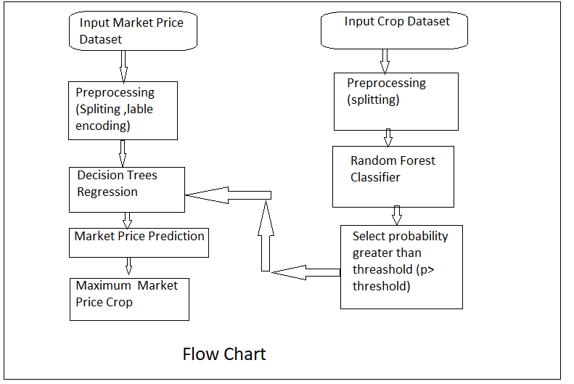
System Architecture

Slide 8
ALGORITHM
RANDOM FOREST CLASSIFIER
INPUT: CROP DATASET
OUTPUT: CROP
PSEUDO CODE:
X:INDEPENDENT FEATURES
Y:DEPENDENT FEATURES
SPLIT X,Y INTO TRAINING AND TESTING DATASET
X TRAIN,X TEST,Y TRAIN,Y TEST
RANDOM FOREST CLASSIFIER: USE MULTIPLE DECISION TREES AND TAKE MAJORITY VOTE

Slide 9
ALGORITHM
DECISION TREE REGRESSION
INPUT: MARKET DATASET
OUTPUT: MARKET SIZE OF CROP
X:Independent features
Y:Dependent Features
Split X,Y into Training and testing dataset
X_TRAIN,X _TEST,Y_TARIN,Y_TEST
DECISION TREE REGRESSION CLASSIFIER: IT CREATE DECISION TREE BASED ON MOST PROBABLE VALUE AND THEN GIVES RESULT IN LESS TIME.
END RETURN CLASS LABELS.

Slide 10
REQUIREMENT ANALYSIS
HARDWARE INTERFACES:
THERE IS NO ANY EXTERNAL HARDWARE REQUIRED ITS RUN ON ITS OWN HARDWARE AS HARD DISK,MULTICORE PROCESSOR , MINIMUM 8GB RAM
SOFTWARE INTERFACES:
PYCHARM, VISUAL STUDIO CODE,BROWSER WHICH WILL SUPPORT HTML5

Slide 11
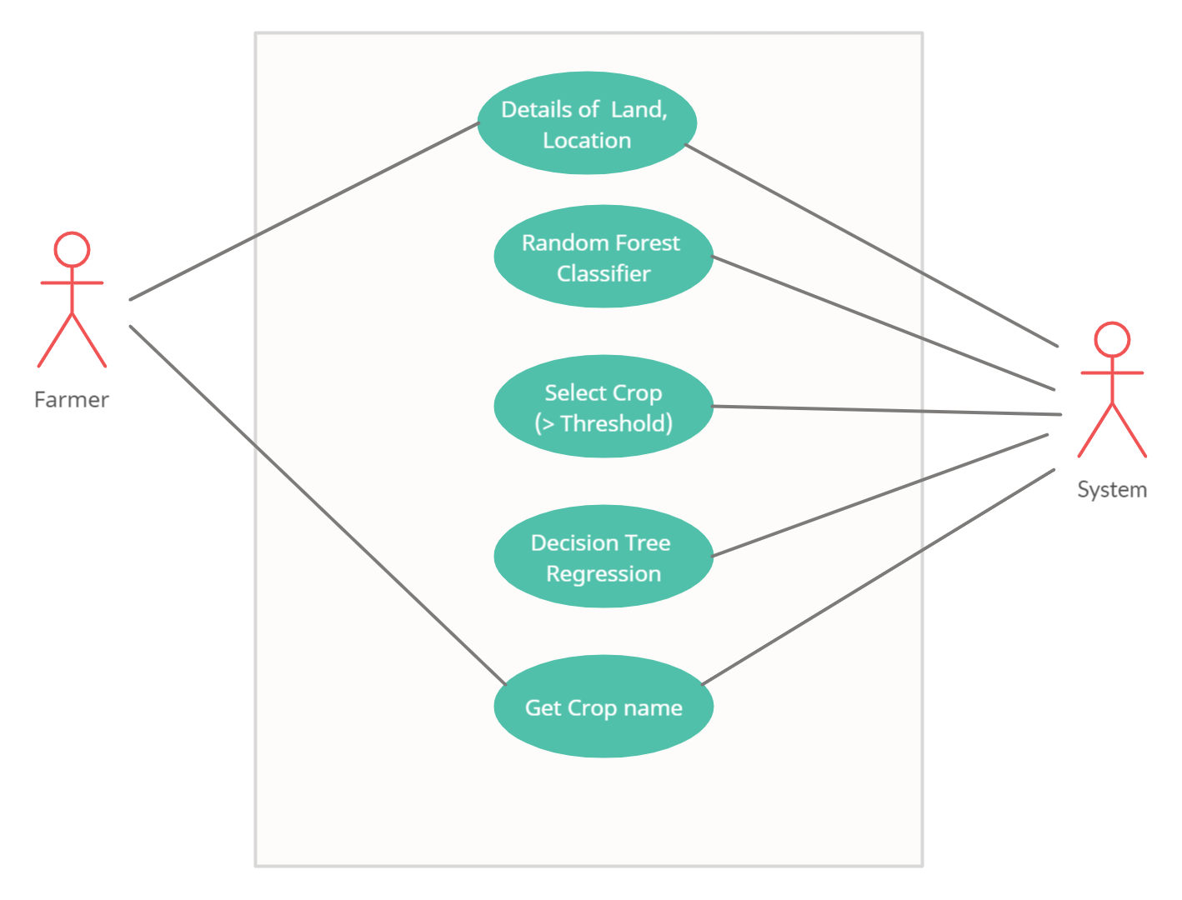
CASE DIAGRAM

Slide 12
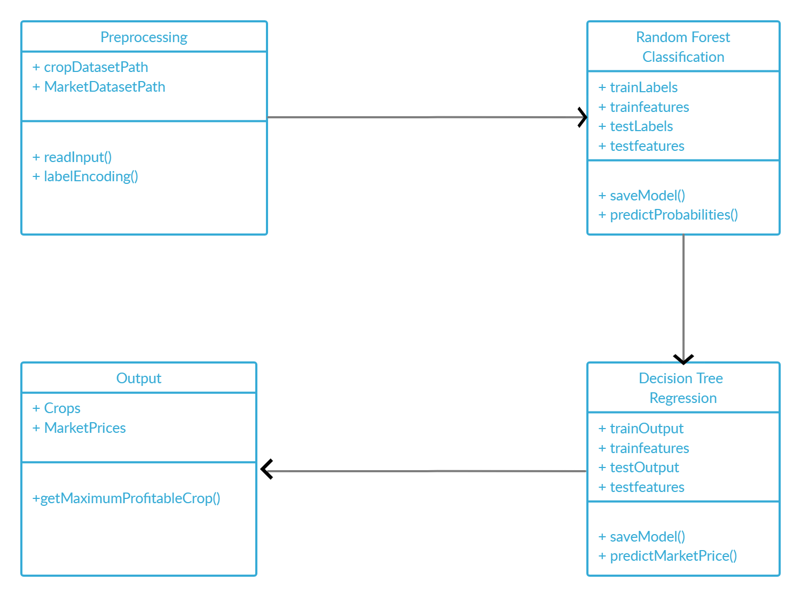
CLASS DIAGRAM

Slide 13
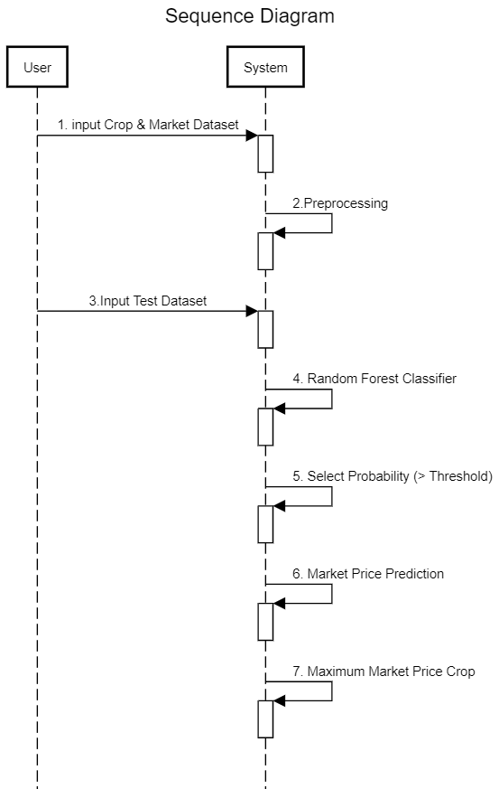
SEQUENCE DIAGRAM

Slide 14
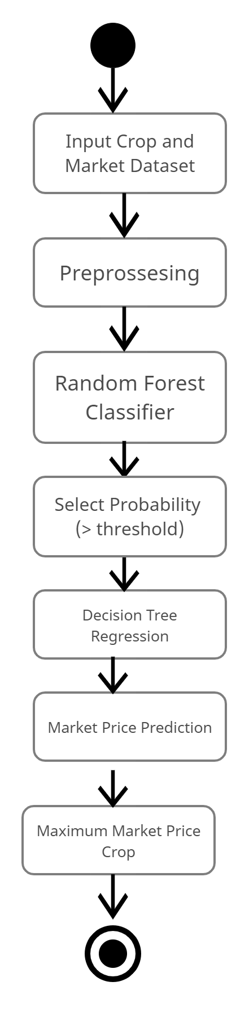
ACTIVITY DIAGRAM

Slide 15
CONCLUSION
The proposed system takes into consideration the data related to soil, weather and past year production and suggests
which are the best profitable crops which can be cultivated in the apropos environmental condition. As the system lists out
all possible crops, it helps the farmer in decision making of which crop to cultivate. Also, this system takes into
consideration the past production of data which will help the farmer get insight into the demand and the cost of various
crops in market. As maximum types of crops will be covered under this system, farmer may get to know about the crop
which may never have been cultivated.

Slide 16
References
Komal “PREDICTION OF CROP YEILDS BY USING DATA ANALYSIS” irjmets, Volume:02/Issue:06/June -2020
Potnuru Sai Nishant, Pinapa Sai Venkat, Bollu Lakshmi Avinash, B. Jabber “Crop Yield Prediction based on Indian Agriculture using Machine Learning” IEEE 2020
S.Bhanumathi worked on “Crop Yield Prediction and Efficient use of Fertilizers” IEEE 2019.
data.gov.in.” [Online]. Available: https://data.gov.in/

Slide 17
Thank YOU

